Slide 1



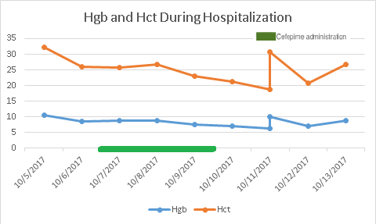
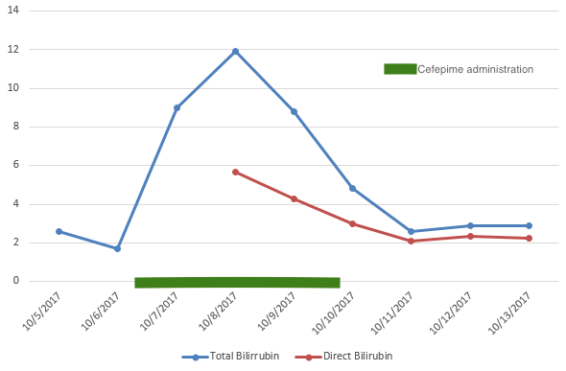
CASE: Cephalosporin induces Warm-type Autoimmune Hemolytic Anemia in Chronic Hepatitis C Infection.
REPLACE THIS BOX WITH YOUR ORGANIZATION’S
HIGH RESOLUTION LOGO
REPLACE THIS BOX WITH YOUR ORGANIZATION’S
HIGH RESOLUTION LOGO
Madalitso Chundu, MD^{1,2}; Jeffrey Ahn MD^{1,2}; Daniel Amponsah MS3, Shannice Baker MS3, Jose Rodriquez MD², and Gary Thompson, DO^{1,2}
¹Loma Linda University Medical Center , ²Riverside University Medical Center
Introduction
The etiologies of hemolytic anemia are broadly classified into intrinsic and extrinsic causes. Immune mediated causes of hemolytic anemia are further subdivided into warm and cold hemolytic anemia. Here, we present a complex case of cephalosporins as a likely contributor to Warm Autoimmune Hemolytic Anemia in a patient with untreated Chronic Hepatitis C cirrhosis.
Case
A 31-year-old male with decompensated cirrhosis secondary to chronic untreated Hepatitis C and Alcoholic liver disease was admitted for recurrence of right lower extremity MRSA cellulitis. His past medical history was significant for a prior admission for right lower extremity cellulitis. In this prior admission he was treated with IV Vancomycin and Cefepime for 3 days and was discharged home on oral doxycycline and levaquin. The patient reported increasing swelling, erythema and tenderness in wide distribution from ankle to mid-thigh, which prompted the patient to present to the hospital. He was admitted to internal medicine service for the management of acute on chronic cellulitis.
Upon admission, the patient was switched to the antibiotics used during the previous admission (Vancomycin and Cefepime). Concurrent with this switch was a progressive worsening of anemia and associated elevations in hemolysis markers. Specifically, Hemoglobin and hematocrit acutely decreased from admission level of 9mg/dL and 29% to nadir of 6.4mg/dL and 18.7% on 6th day of admission (Figure 1). At the same time, Total bilirubin significantly up trended from 2.6mg/dL on admission peaking at 11.9mg/dL (direct bilirubin 5.68mg/dL) on days 3-4 (Figure 2). Reticulocyte count was elevated at 2.3%, Haptoglobin <15 and LDH 632. Blood peripheral smear showed moderate anisocyotsis and poikilocytosis but no morphologic evidence for parasites, spur cell anemia or microangiopathic hemolytic anemia. Abdominal ultrasound was obtained which showed mild gallbladder wall thickening otherwise unremarkable findings. Significantly, liver enzymes stayed at their baseline throughout the admission. Direct Coombs testing was positive for Warm AIHA (DAT Poly AHG positive) and negative for Cold Agglutins (DAT C3 negative). HIV was non-reactive, Hepatitis A total Ab and IgM was non-reactive, Hepatitis B Core and Surface Ag were non-reactive while Hep C Ab was reactive. Lastly, he underwent an EGD and colonoscopy. EGD showed mild antral erythema with no evidence of varices and colonoscopy did not show any sources of bleeding. Vancomycin and Cefepime were subsequently exchanged for oral Levaquin and Doxycycline on day 6 of admission.
By day 8 of hospitalization, hemoglobin and bilirubin level returned to his baseline. Patient showed significant improvement with cellulitis thus discharged to skilled nursing facility with plans to follow up with primary care physician.
Discussion
Here we present a case that shows cephalosporin/drug induced hemolytic anemia as a possible mechanism underlying the induction of warm-type AIHA in a patient with Chronic Hepatitis C. This patient underwent a comprehensive diagnostic work-up to rule out other potential causes of acute anemia in decompensated cirrhosis and showed a definite temporal association between Cefepime use and acute anemia (figure1). Cephalosporins are one of the most common causes of drug induced hemolytic anemia. Depending on type and generation, the mechanism associated with the hemolytic anemia differs. For example cefotetan, a second-generation cephalosporin, covalently binds and attaches to the RBC coat inducing extravascular immune hemolysis via macrophage Fc receptor recognition. Ceftriaxone, a third-generation cephalosporin, covalently or non-covalently binds to RBC membrane creating a neoantigen. Antibodies are then able to react with the drug, drug plus the RBC membrane, or the membrane portion of the neoantigen.(Pierce 2011). As is illustrated by this case, discontinuation of the Cephalosporin can result in resolution of acute hemolysis and stabilization of anemia. Earlier reports by Chao and Srinivasan also suggest a possible benefit of a course of steroids for resolution of warm AIHA in patients with chronic Hepatitis C.
Figure 1. Hemoglobin and Hematocrit.
Figure 2. T. Bilirubin and Direct Bilirubin .
Contact
References
<your name>
<your organization>
Email:
Website:
Phone:
Chao, T. C. (2001). Chronic hepatitis C virus infection associated with primary warm-type autoimmune hemolytic anemia. Journal of clinical gastroenterology, 232 - 233.
Pierce, A. (2011). Pathology consultation on drug-induced hemolytic anemia. American journal of clinical pathology, 7 - 12.
Srinivasan, R. (2001). Autoimmune hemolytic anemia in treatment-naïve chronic hepatitis C infection. Journal of clinical gastroenterology, 245 - 247.
Weatherall, D. J. (2000). Red cells I: inherited anaemias. Lancet, 1169&1260.

