Slide 1






Senior Case
By: Sedona Valentine, MD, PGY-3
Advisor: Dr. Nader
June 27, 2019

Slide 2
Case
42 y.o. male with PMH Type 2 Diabetes Mellitus, insulin dependent with complications of retinopathy and chronic diabetic right heel ulcer, Hypertension, Hyperlipidemia, chronic low back pain, who presents for abdominal pain, nausea, and vomiting x3 days.

Slide 3
HPI
Sudden onset non-radiating epigastric burning pain 7/10 which has been constant for 3 days, with associated nausea and non-bilious non-bloody emesis ~12x.He felt increasingly fatigued, having difficulty sleeping, subjective fever, palpitations and occipital headache but no dizziness. He states the only trigger for symptoms were homemade tacos immediately prior to onset. Pain is worse with laying back and better with leaning forward, barely able to tolerate water, unsure if food is associated, as he has not been able to eat since.
He has had symptoms like this in the past which come and go, starting at 18yo, has had at least 3 prior episodes (at 18yo, 26yo, 30yo) but usually symptoms resolve in 1-2 days.

Slide 4
HPI
He has had unexplained 50 lb weight loss in last 5 years. Of note, he is currently hypertensive 200s/110s and states that his BP goes up and down without known cause. Has BP meds which he doesn't take because he states they make him feel very "funny", stating he has had more "normal BPs" but does not feel well.
He has chronic diabetic ulcer which he follows in podiatry for, starting this past Thursday, he notes right lateral foot at 5th toe appeared more red and swollen but not causing him significant pain. No drainage. Has multiple lower extremity wounds, but no new or worsening other than the wound of the right lateral foot.

Slide 5
Other history
PMHx: Type 2 Diabetes Mellitus, insulin dependent with complications of retinopathy and chronic diabetic right heel ulcer, Hypertension, Hyperlipidemia, chronic low back pain
No surgeries
Family history: CAD in his father; Hypertension in his mother.
Social history: Lives at home with kids and wife. Denies tobacco, alcohol, or drug use.

Slide 6
Vitals
Temp: [97.8 °F (36.6 °C)-99.6 °F (37.6 °C)] 99.6 °F (37.6 °C)
Heart Rate: [93-117] 115
Respirations: [12-21] 20
Blood Pressure: (117-217)/(74-127) 128/91
SpO2: [96 %-100 %] 100 %

Slide 7
Physical Exam
General appearance - alert, appears fatigued, thin, but in no acute distress
Mouth - mucous membranes moist, pharynx normal without lesions and no oral thrush, multiple cavities but dentition intact, no foul odor mouth
Neck - supple, no significant adenopathy, no JVD, no thyromegaly
Lymphatics - no palpable lymphadenopathy, no hepatosplenomegaly
Heart - tachycardia, Grade 3/6 systolic murmur, normal rhythm, no rubs or gallops
Chest - clear to auscultation, no wheezes, rales or rhonchi, symmetric air entry
Abdomen - soft, flat abdomen, mild tenderness to palpation of epigastrium but no pain at McBurney's point, neg Murphy's, no rebound or guarding, no masses, no CVA tenderness
Neurological - alert, oriented, normal speech, no focal findings or movement disorder noted
Musculoskeletal - no joint tenderness, deformity or swelling
Extremities - peripheral pulses bounding 3+, no pedal edema, no clubbing or cyanosis
Skin - normal coloration and turgor of skin EXCEPT mild hyperpigmentation of bilateral lower extremities, various lower extremity superficial ulcerations with irregular borders, largest at bilateral shins, Right foot at 5th MTP joint area with chronic RLE

Slide 8
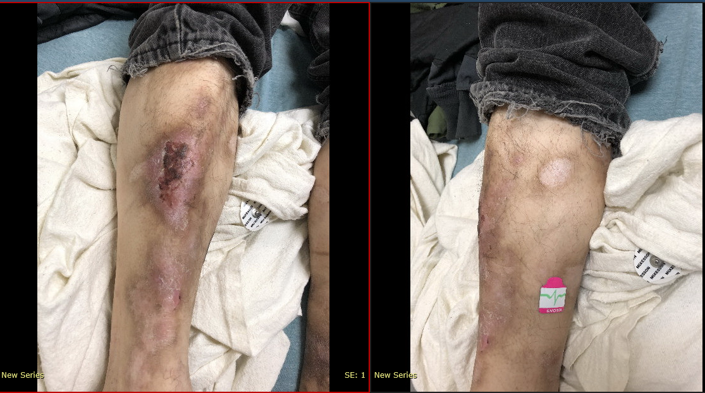
Physical Exam

Slide 9
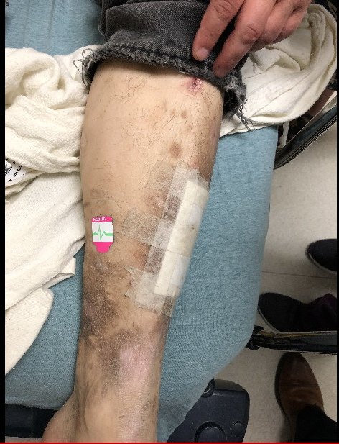
Physical Exam

Slide 10
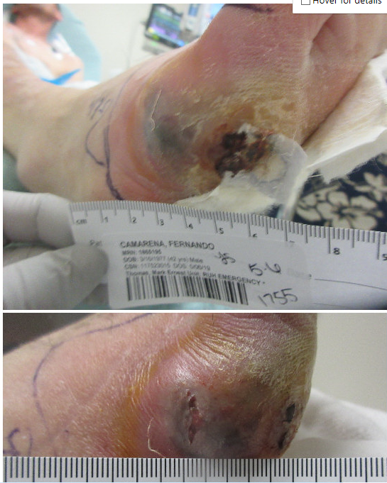
Physical Exam

Slide 11
Differential? What should we order?
Labs?
Imaging?

Slide 12
Labs on Admission
WBC 22.2*
HGB 15.5
HCT 45.8
MCV 84.4
PLT 285
NA 130*
K 4.4
CL 95*
CO2 26
BUN 43*
CREATININE 1.36*
CA 9.9
ALBUMIN4.0
TOTALBILI 0.6
ALKPHOS 156*
ALT 21
AST 11*

Slide 13
Imaging XR Rt Foot
IMPRESSION: Interval increase in soft tissue swelling with development of subcutaneous gas corresponding with ulcer site in the region of the fifth metatarsal head extending under the fourth metatarsal compatible with ulcer and drainage tract with associated cellulitis. No underlying radiographic evidence of osteomyelitis.

Slide 14
Imaging- MRI Rt Foot
IMPRESSION: There does appear to be focal marrow edema demonstrated of the fifth proximal phalanx, fifth middle and distal phalanx with enhancement which may reflect osteomyelitis.
There also appears to be focal marrow edema noted of the lateral malleolus of the distal fibula with mild enhancement. This is a questionable and may not represent osteomyelitis. This may reflect a focal area of microtrauma.
There does appear to be subcutaneous edema noted along the dorsal and plantar aspect of the midfoot and forefoot as well as along the plantar surface of the hindfoot which may reflect cellulitis however there is no definite evidence for mature abscess.

Slide 15
Imaging- Ultrasound of Gallbladder
IMPRESSION: There are findings which may reflect mild fatty infiltration of the liver. Underlying hepatocellular pathologic process cannot be excluded.
There are findings which may reflect gallbladder sludge but without definite evidence for shadowing stones.
There is no definite evidence for acute cholecystitis.
There are findings suggestive for mild right hydronephrosis. The does appear to be a 4.3 x 3.7 x 5.4 cm complex appearing solid mass which appears superior and medial to the right kidney of questionable etiology. Please see CT scan of the abdomen done same day.

Slide 16
Imaging- CTAP
CT Abdomen & Pelvis with contrast
FINDINGS:
Adrenals:There is a prominent right adrenal mass, which measures
4.4 x 4.7 cm maximally, with heterogeneous internal
attenuation/enhancement, potentially with areas of other cystic
changes or necrosis anteriorly.
IMPRESSION:
1. Right adrenal mass measuring up to 4.7 cm. Differential considerations include primary and metastatic lesions. There is a known cancer primary, consider PET CT or biopsy for further assessment. Otherwise, surgical referral for potential resection is recommended.
2. Bilateral inguinal adenopathy. The right inguinal lymph node is close to the skin surface, and would be amenable to percutaneous biopsy if needed

Slide 17
Imaging MRI Abdomen
IMPRESSION: There does appear to be a complex appearing mostly solid mass lesion of the right adrenal gland measuring 4.3 x 4.5 x 5 cm with heterogeneous enhancement demonstrated. There appears to be multiple heterogeneous appearing cystic structures involving the mass somewhat which contain fluid fluid levels. These may reflect multifocal areas of internal necrosis. There is no definite evidence for increased fatty content of the mass lesion and does not appear to be typical for adrenal adenoma.
Given complex appearance and enhancement of the mass structure of the right adrenal gland, this may reflect a pheochromocytoma especially given clinical history. An adrenal adenocarcinoma or metastatic disease cannot be entirely excluded but seems less likely.

Slide 18
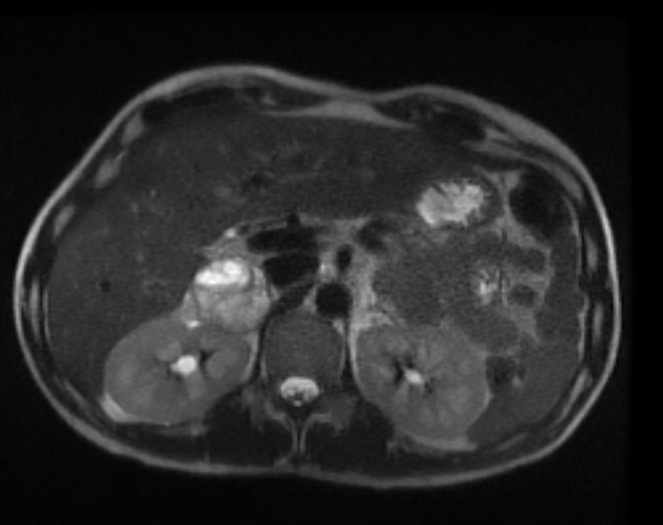
Imaging

Slide 19
Imaging- CT Chest
IMPRESSION:
No evidence of metastatic disease. Subpleural opacity in the right lower lobe most likely postinflammatory given its location.

Slide 20
What happened next…
Patient went to OR for I&D of abscess. While at PACU patient's BP went from SBP 140s to 220s requiring labetalol pushes. Patient admitted to MICU for BP monitoring and nicardipine gtt.
MICU course:
On nicardipine gtt for about 24 hours. Then started on doxazosin and IV labetalol prn.
Transitioned to Doxazosin 4mg and PO Labetolol 50mg BID for discharge

Slide 21
Pheochromocytoma
Catecholamine-secreting tumors that arise from chromaffin cells of the adrenal medulla
These occur in less than 0.2% of patients with hypertension
Annual incidence is 0.8 per 100,000 person-years
Most common in the 4th to 5th decade and equally common in women and men
Most are sporadic (found incidentally or d/t symptoms), but 40% are part of a familial disorder.
Associated familial disorders: VHL, MEN2, NF1

Slide 22
Clinical Presentation
Classic triad: episodic HA, sweating, and tachycardia. Half have paroxysmal hypertension (although 5-15% have normal BP)
Paroxysmal hypertension: elevations in BP during diagnostic procedures, induction of anesthesia, surgery, or with substances containing tyramine
Presenting in crisis may have: hypertension or hypotension, hyperthermia, AMS, and other organ dysfunction.
Other symptoms: orthostatic hypotension, visual blurring, papilledema, weight loss, insulin resistance, hyperglycemia, leukocytosis, cardiomyopathy

Slide 23
Tumor characteristics
95% of the catecholamine secreting tumors in abdomen with 85-90% intra-adrenal. 10-15% are catecholamine-secreting tumors are extra-adrenal and are called paragangliomas
10% are malignant (clue it might be malignant: local invasion into surrounding tissues and organs or distant mets)

Slide 24
When should you test your patient?
Classic triad: HA, sweating, tachycardia (whether or not HTN is present)
Hyperadrenal spells (nonexertional palpitations, diaphoresis, HA, tremor, pallor)
If onset of HTN is <20 years old, resistant HTN, HTN with new onset or atypical DM
If familiar syndrome is present, family history of pheo, adrenal incidentaloma (w or wo HTN)

Slide 25
What meds should you continue or discontinue?
Continue all antihypertensive meds
Flexeril, TCAs, Levodopa, decongestants (drugs containing adrenergic receptor agonists), amphetamines, Prochlorperazine, Reserpine, Ethanol; all can increase measured levels of catecholamines and metanephrines.
Discontinue/taper above. Pt needs 2 weeks off those meds prior to testing

Slide 26
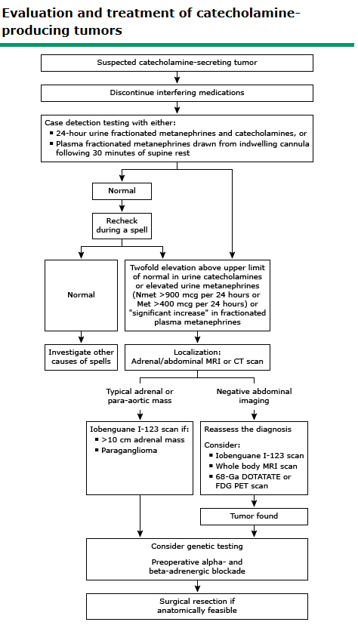

Slide 27
Tests to Order
24 hour urine fractionated metanephrines and catecholamines or
Plasma fractionated metanephrines drawn from indwelling cannula following 30 minutes of supine rest
If those are normal, re-check during a spell
Abnormal results: Two fold elevation above upper limit of normal in urine catecholamines or elevated urine metanephrines (Nmet>900mcg/24h or Met>400 mcg/24h) or a “significant increase” in fractionated plasma metanephrines
Next: Adrenal abdominal MRI or CT→ whole body scan
Prior to surgery will need alpha and beta adrenergic blockade
Consider genetic testing

Slide 28
Prepping for Surgery
Control BP and tachycardia
Combined alpha and beta adrenergic blockage to avoid intraoperative HTN crisis
DOC: Phenoxybenzamine, however more favorable side effect profiles and lower cost are the selective alpha-1 adrenergic blocking agents (prazosin, terazosin or doxazosin)
BP monitoring BID with target <120/80 seated, with systolic >90 standing
High Na diet due to volume induced contraction and orthostasis with alpha adrenergic blockage

Slide 29
Prepping for Surgery
Once alpha blockage has been achieved, beta-adrenergic blockage is initiated, 2-3 days preop
NEVER start beta blockage first because blockage of vasodilatory peripheral beta-adrenergic receptor stimulation can lead to further elevation in BP.

Slide 30
Prognosis Post Op
Surgical removal of pheo does not always lead to long term cure of pheo or HTN, even if it is a benign tumor
Recurrence was more likely in patients with familial pheochromocytoma
Will need long term monitoring, as metastatic disese can be discovered over 50 years after initial surgery
Recommend yearly biochemical screening
Of note, no curative treatment for metastatic pheochromocytoma unless sites of disease can be removed surgically

Slide 31
Back to our patient…
Metanephrine, free: 168 (<57)
Normetanephrine, free: 770 (<148)
Total free (MN +NMN): 938 (<205)
24h urine MN: 3915 (58-203)
24h urine NMN: 2625 (88-649)
24h urine MN total: 6540 (182-739)

Slide 32
More labs
Urine Cortisol 268.2 (40-50) Androstenedione 51 (40-190)
Urine creatinine 2.40 (0.50-2.15) 24h urine epi 571 (2-24)
Calcitonin <2 (<10) 24h urine NE 698 (15-100)
DHEA sulfate: 47 (70-495) Total E +NE 1269 (26-121)
ACTH 16 (6-50) Dopamine 258 (52-480)
Testosterone total: 89 (250-1100)

Slide 33
NM Tumor Imaging
Findings: Normal uptake of activity is seen in thyroid gland, salivary glands, liver, spleen, bladder and colon. Abnormal activity is not seen.
Impression: No abnormal uptake of MIBG is identified, especially no focal activity is identified within the adrenal glands

Slide 34
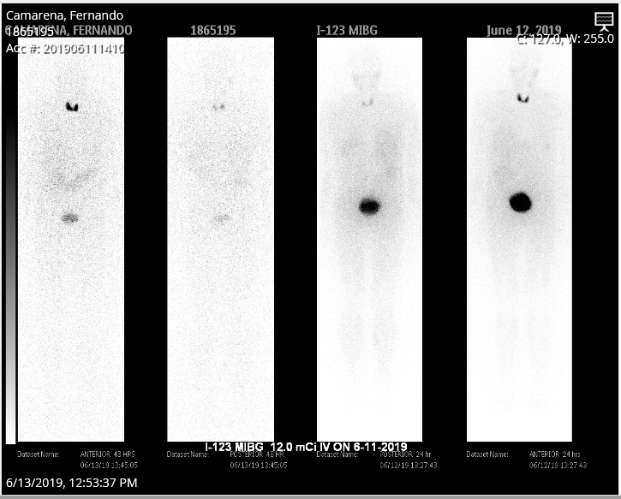
NM Tumor Imaging

Slide 35
Final Patient Update
Original surgery date 6/28/19 cancelled due to poorly controlled DM (A1C 12.6%)
Pre-op Urology appointment on 7/1/19
Tentative surgery is planned for 7/19/19
Endocrinology referral pending

Slide 36
References
Uptodate
DynaMed

Slide 37



Thank you! Questions?

