Slide 1
Bilateral Lower Extremity Weakness
Michelle Choi DO, PGY 3
Adviser: Dr. Nader

Slide 2
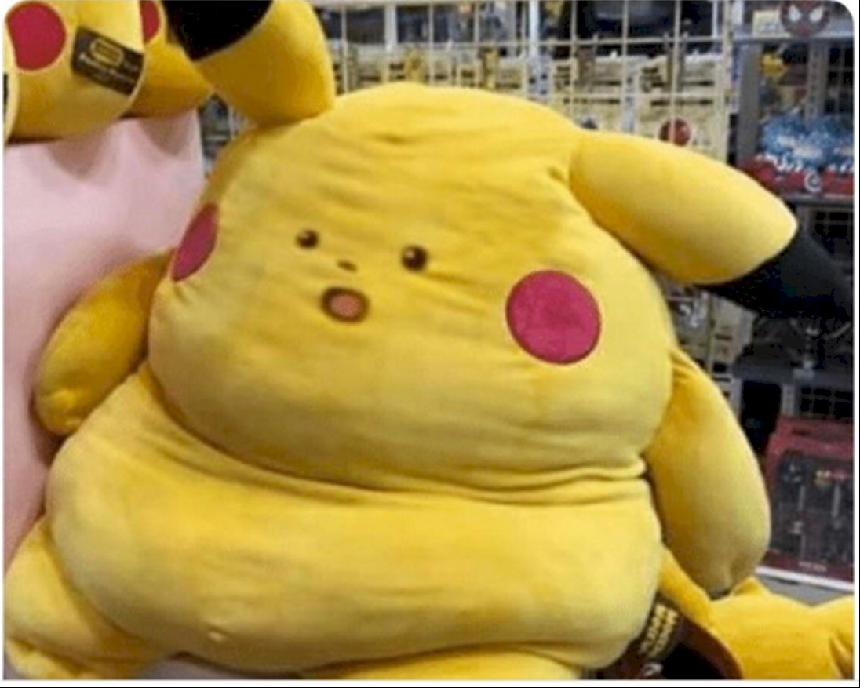
Patient:
“I hurt my back at work in February. My work put me on modified work duty and physical therapy. I went back to full work last week and my back is hurting more and my legs feel weak and tingly.”
Mom:
“And he doesn’t want to eat and has lost so much weight. He is tired all the time.”
Me:
Disability paperwork?

Slide 3
HPI
30yo M BLE numbness/ weakness x4 days
numbness starts at level of abdomen
sharp pain in upper back and lower back x1 month
Job: picking up barrels of recycled paper for compaction.
Work accident 4 months ago → sudden onset pressure like LBP
Had abnormal lumbar XR at urgent care at that time
Normal XR through workman’s comp subsequently.
Placed on modified work restriction and PT and back pain improved.
Started to increase work activity level this week and now has increased pain and new onset numbness/ weakness.
Denies saddle anesthesia, urinary/ bowel incontinence, h/o IVDU.

Slide 4
ROS
Constitutional: + decreased appetite, no fevers/ chills
HENT: neg
Eyes: neg
Resp: neg
Cardio: neg
GI: neg
Endo: neg
GU: no urinary incontinence
MSk: +back pain, gait problem, no neck pain, myalgia, joint pain
Skin: neg
Neuro: + weakness, numbness, no saddles anesthesia or urinary/ bowel incontinence, no HA, dizziness, seizures
Psych: neg

Slide 5
PMH/ PSH/ Meds/ Allergies/ SHx/ FHx
Seizure
  Keppra 1500mg BID
No prior surgeries
NKDA
Denies tobacco/ etoh/ IVDU
Asthma (Mother, Sister)

Slide 6
Physical Exam
Constitutional: No acute distress.
HENT: wnl
Cardio: RRR, no murmur
Resp: CTAB, no wheezes, crackles
Abd: obese, nontender, soft
Skin: no rash, warm and dry
Psych: normal mood/ affect

Slide 7
MSk:
  point spinal tenderness at T3/T4 and L4/L5.
  BUE strength abduction, elbow flexion/ extension, hand grip 5/5.
  Hip Flexion: Left 3/5, Right 4/5
  Knee flexion/ extension: Left 5/5, right 5/5
  Extensor hallucis: Left 4/5, Right 5/5
  Plantar flexion/extension: Left 4/5, Right 5/5
Neuro:
  Decreased sensation starting around T6-7 dermatomal level (midway between nipple line and umbilicus) to bilateral feet.
  DTR: C5, C6, C7 2+ bilaterally. L4 3+ bilaterally, S1: 2+ on left, unable to elicit on right
Notes:
Hip flexors: L2-L4
Deep peroneal(fibular) nerve, branch of common peroneal(fibular) nerve (L4, L5, S1).

Slide 8
Labs?
Imaging?

Slide 9
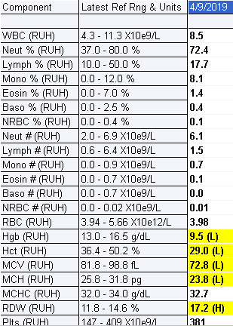
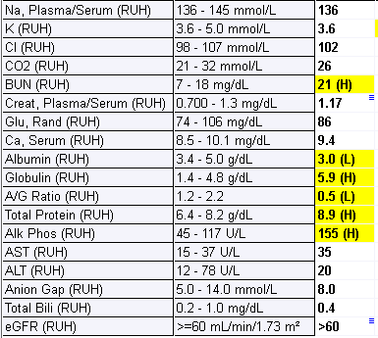
Labs

Slide 10
MRI T-spine with contrast
Enhancing T2 bright and relatively isointense or decreased T1 signal lesions in T2, T6, T8, T11 vertebral bodies
T2 vertebral body with contiguous extradural mass extending superiorly to the C7-T1 level on left, and inferiorly to the T2-3 level bilaterally
Abnormal enhancing lesion of T6 vertebral body on right
Associated severe central spinal stenosis and narrowing/ compression of the caliber of the thoracic cord at the T2 level

Slide 11
MRI L-spine with contrast
Conus medullaris shows normal signal, terminating at T12
Abnormal signal and enhancement of T11, L1, L2, L3, L4 vertebral bodies
Abnormal signal and enhancement of L3 transverse body extending to adjacent paraspinal musculature suspicious for metastatic disease
L4 vertebral body with irregular appearance superior end plate – Schmorl’s node vs ?compression deformity
Enhancing mass in extradural, epidural space at the L4 level contiguous with the vertebral body mass
2.5x1.1cm mass extending posteriorly from L4 vertebral body causing moderate spinal canal stenosis
Periaortic/ retroperitoneal lymphadenopathy

Slide 12
Cancer in Young Adults
Breast cancer
Lymphomas (non-Hodgkin and Hodgkin)
Melanoma
Sarcomas (cancers of connective tissues like muscles and bones)
Cancers of the female genital tract (cervix and ovary)
Thyroid cancer
Testicular cancer
Colorectal cancer
Brain and spinal cord tumors

Slide 13
CT Chest with contrast (4/10/2019)
9.4 mm lung nodule at right lung base adjacent to the diaphragm
Multifocal lytic change of the thoracic skeleton
Retroperitoneal adenopathy
Multifocal hepatic masses

Slide 14
CT Abd/Pelvis with contrast (4/10/2019)
Abnormal multifocal heterogeneous hepatic lesions with the largest lesion measuring approximately 5 x 5.6 cm in the inferior right hepatic lobe worrisome for metastases.
Abnormal necrotic upper abdomen mesenteric and retroperitoneal adenopathy, very suspicious for metastases.
Diffuse osseous metastases with pathologic fracture deformity of the superior anterior endplate L5.
? Hyperemia of the left testis, incompletely evaluated. Follow-up testing ultrasound recommended to exclude possibility of testicular neoplasm.

Slide 15
Admitted to IM (4/10-4/22/19)
States he has noticed left testicular mass for several months
Scrotal US (4/10/19):
  Normal right testicle
  Left testicle: entire testis is replaced by a heterogeneous soft tissue structure with cystic changes and decreased flow or areas with no flow. Echogenic foci may represent small amount of air or could be calcifications.
  This mass measures 12.1 x 8.6 x 7.8 cm.
Tumors markers obtained: AFP 7429.4, β HCG 359 and LDH 1419

Slide 16

In hindsight…

Slide 17
Hospital Course (4/10-4/22/2019)
Urology and Ortho consulted, Decadron started (4/10-4/14) awaiting spine sx
MRI C-spine and brain negative for mets
4/12/19: Left radical orchiectomy
4/13/19:
  Bilateral laminectomy T1-T2, T2-T3 for excision of intraspinal tumor.
  Posterior segmental instrumentation C7 to T4.
  Posterolateral fusion C7-T1, T1-T2, T2-T3, and T3-T4.
  Harvesting of iliac crest bone graft.

Slide 18
Hospital Course (4/11-4/22/19)
Path reports:
Left testis:
  Mixed germ cell tumor, consisting of 80% yolk sac tumor, 10% Teratoma, postpubertal type, 5% Embryonal carcinoma, and 5% seminoma
  Tumor size 11cm in greatest dimension, limited to testis, with focal necrosis, no lymphovascular invasion
T2 vertebral body tumor
  Metastatic tumor morphologically is similar to the tumor
  found from patient's left testicle (a mixed germ cell tumor)
4/19/22: Oncology consulted, f/u outpatient for chemo with baseline PFT, DLCO
4/22/19:Discharged to SNF with Port-a-cath
Notes:
DLCO: diffusing capacity for carbon monoxide – looks at the extent to which oxygen passes from the alveoli to the blood stream

Slide 19
Outpatient follow ups
f/u with Urology, Ortho, and PCP
4/23/19 Ortho clinic note: BUE strength : 5/5, RLE strength 5/5, LLE 4/5, BUE/ BLE sensory normal
5/2/2019 Oncology:
  Stage IIIc testicular cancer (pT1b cN3 pM1b S3)
  Start chemo (Bleomycin, cisplatin, etopoxide)
  Tumor markers continue to rise: AFP 20025.5, β HCG 400 and LDH 1911

Slide 20
Hospital course #2 (5/21-5/26/19)
Admitted from Hem/Onc clinic due to worsening BLE weakness, urinary/ bowel incontinence, concerning for cord compression
Also started on Lovenox for IVC thrombus while outpatient
Ortho consulted: BLE strength 0/5, sensation 0/2, T6-T12 sensation 0/2 bilaterally
MRI C and T spine: no cord myelopathy
MRI L spine:
  diffuse skeletal metastases. Epidural mets causing L5 severe central spinal canal stenosis and mild central spinal canal stenosis at L2 and L3 levels.
  Large bilobed 8 x 5 cm transverse LEFT iliopsoas/retroperitoneal heterogeneous enhancing mass extending to the left quadratus lumborum muscle at the L4 level.
Completed 5 days of chemo and dc to SNF with decadron and Lovenox
Notes:
Ortho discussed about surgery with patient, low likelihood that he will neural symptoms will recover based on duration of symptoms

Slide 21
Hospital Course #3 (5/31-6/27/19)
Admitted for neutropenic fever, sepsis 2/2 UTI. Hospital course c/b C. diff colitis and hypotension
Since discharge, had 4 cycles of chemo, tumor markers normalized. Oncology plan to refer to Loma Linda for higher level of care regarding liver mets, which have decreased in size.

Slide 22

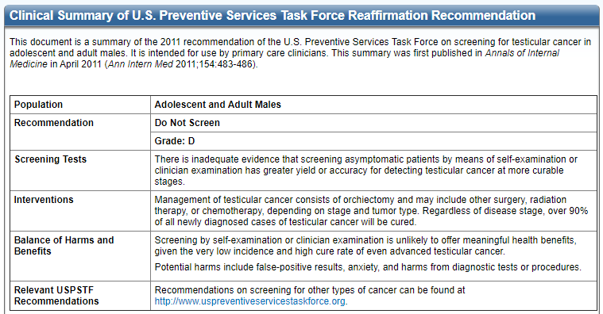
USPSTF Guideline on Testicular Cancer Screening
Notes:
Also recommended against screening for asymptomatic males by the AAFP and Choosing Wisely campaign
http://www.choosingwisely.org/societies/american-academy-of-family-physicians/

Slide 23
Testicular Cancer
Seminoma
Sex cord/ Stromal
Leydig
Extragonadal
Germ cell tumor
Non-seminoma
Sertoli
Yolk sac
Teratoma
Embryonal
Choriocarcinoma
80%
5 %
10%
5%

Slide 24
Germ cell tumor (GCT)
Account for 95% of all testicular cancer
Seminoma (45%)
  Most treatable: 98-99% cure rate in early stage
  Can see elevated β HCG and LDH, does not secrete AFP
Non seminoma
Mixed germ cell tumor is the most common type, make up 40% of all germ cell tumor
Most common ones are teratoma and embryonal cell carcinoma
Teratoma is more aggressive
70% produce AFP, β HCG, and LDH
Notes:
Germ cell tumors (GCTs) account for 95 percent of testicular cancers
https://www.uptodate.com/contents/clinical-manifestations-diagnosis-and-staging-of-testicular-germ-cell-tumors?search=staging%20nonseminima%20testicular&source=search_result&selectedTitle=1~150&usage_type=default&display_rank=1

Slide 25
Nonseminoma Epidemiology
peak incidence is in men aged 20-34 years.
most frequently seen in non-Hispanic white men. The lowest incidence is in African-American men
Relatively uncommon, estimated 9500 cases in 2019 in the US, however, it is on the rise
Between 1973-1995, rate doubled
Based on 2012-2016 data, the incidence is approximately 5.9 cases per 100,000 men
Internationally, highest incidence in Norway and Denmark, highest rate of rise in Southern Europe and Latin America

Slide 26
Etiology
Exact etiology unknown
Thought to be related to intrauterine assault and originate in fetal life
10% of patients has h/o Cryptochidism
undescended testicle has at least 4x the risk for carcinoma compared to a normal testicle.
This risk is increased regardless of the age at repair.

Slide 27
Presentation
Classically: Painless or sometimes painful scrotal mass in an otherwise healthy male in 30-40s
DDx: testicular torsion, epididymitis, or epididymo-orchitis.
Less common: hydrocele, varicocele, hernia, hematoma, spermatocele, or syphilitic gumma
Ask:
  Personal h/o undescended testes?
  When was orchidopexy done?
  First degree relative with testicular cancer
Notes:
https://emedicine.medscape.com/article/454477-clinical

Slide 28
Work up
Scrotal US:
  Cystic/ fluid filled lesion: unlikely malignancy
  Seminoma: well-defined hypoechoic lesions without cystic areas
  nonseminomatous germ cell tumors: typically inhomogeneous with calcifications, cystic areas, and indistinct margins
  Microlithiasis: defined as 5+ echogenic 1 to 3 mm foci in a single cross-sectional ultrasound image
    Retrospectively, strong association with testicular cancer
    In otherwise low risk patients, no f/u US needed, but should be taught self testicular exam

Slide 29
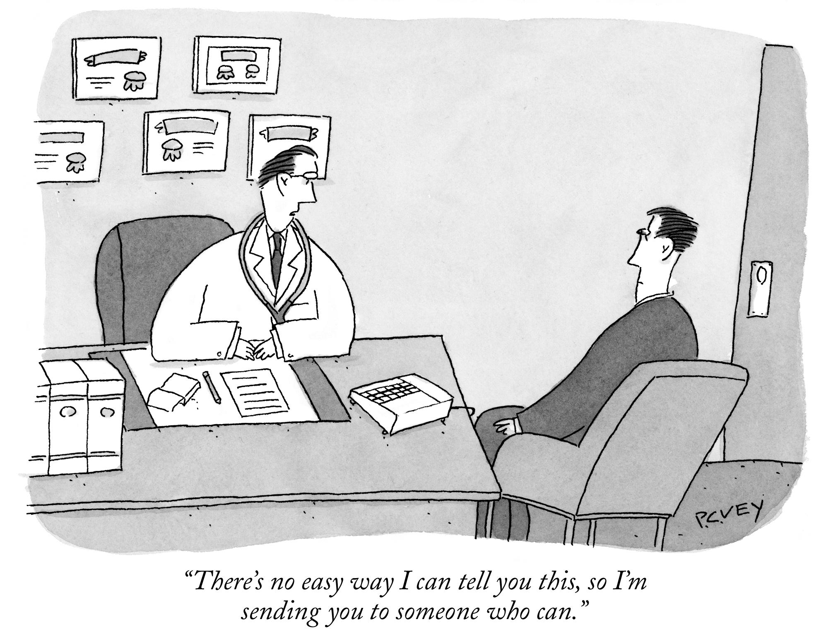

Slide 30
Work up
CT chest and abd/pelvis to look for metastasis
Regional metastases first appears in retroperitoneal lymph nodes, specifically the paraaortic lymph nodes
MRI and PET scan has little utility
Tumor markers:
  AFP, β HCG and LDH
  β HCG and LDH : elevated in 80 to 85% of men with NSGCTs, even when non-metastatic
  β HCG is elevated in < 20% of testicular seminomas, and AFP is not elevated in pure seminomas

Slide 31
Staging
TNM system: primary tumor (T), lymph nodes (N), and distant metastases (M) + serum tumor marker values (S) β HCG, AFP, and LDH to define prognostic stage groups from I to III
because of the availability of serum tumor marker and the predictable metastatic pattern, biopsy of mets are not always necessary except in unusual places (ie bone)
Notes:
https://www.uptodate.com/contents/image?topicKey=ONC%2F2980&search=testicular%20cancer%20etiology&imageKey=ONC%2F110731~ONC%2F110732&rank=1~150&source=see_link
As family medicine, we are not going to be the one staging cancers but it’s good to know how it works. For testicular cancer staging and predicting prognosis, it uses the TNM system plus tumor marker levels that are drawn after orchiectomy.

Slide 32
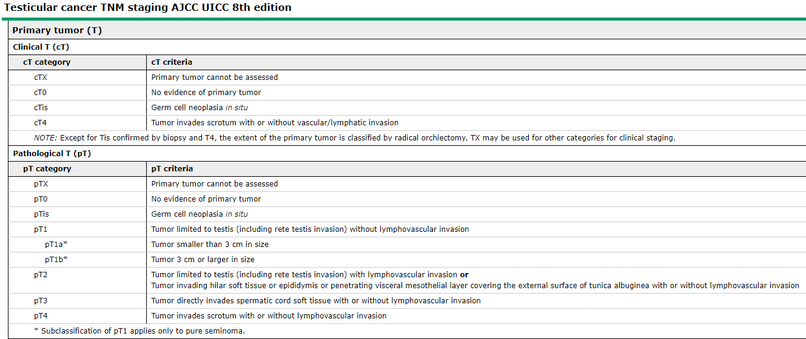

Slide 33
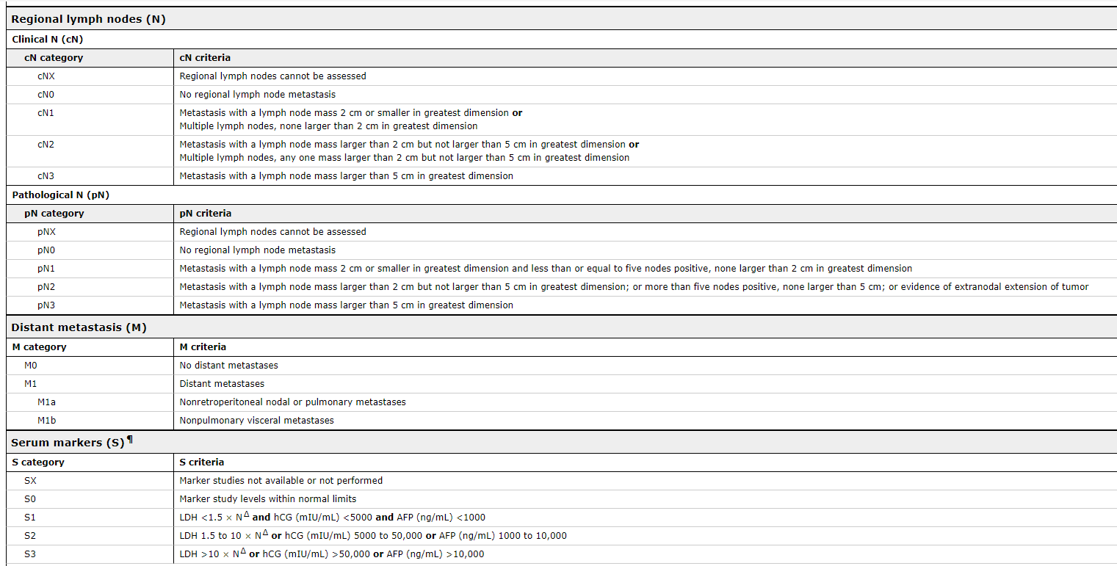

Slide 34
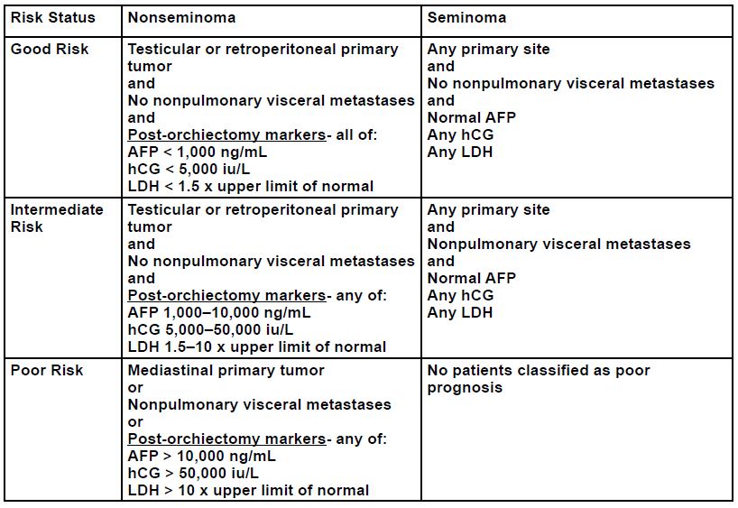
Risks

Slide 35
Prognosis
Early disease: 95-98% cure rate
Seminoma
  approximately 90% of men with advanced seminoma had good-risk disease and an excellent prognosis following orchiectomy alone. In the 1997 publication 5-year progression-free survival (PFS) and overall survival (OS) rates were 90 and 92 percent, respectively.
  Approximately 10% of men with seminoma had intermediate-risk disease. Their five-year PFS and OS rates were 67 and 72 percent, respectively.

Slide 36
Prognosis
Nonseminomatous germ cell tumor
  Good-risk metastatic NSGCTs (56%): 5-year PFS and OS rates for these patients were 89 and 92%, respectively.
  Intermediate-risk disease (28%): 5-year PFS and OS rates were 75 and 80%, respectively.
  Poor-risk disease (16%): 5-year PFS and OS rates for these patients were 41 and 48%, respectively. However, more recent studies have reported better results for poor-risk patients

Slide 37
Treatment
Radical orchiectomy (inguinal approach)
Chemotherapy
  Bleomycin, etoposide, and cisplatin
  ifosfamide, etoposide, and cisplatin

Slide 38
After care
Seminoma, the median time to relapse is 13 to 16 months, but up to 1/3 of relapses occur > 3 years after completion of treatment
NSGCT: > 95% occur within the first 2 years following orchiectomy
No guideline on how frequent follow up imaging and tumor markers should be obtained
most groups now recommend that follow-up continue for at least ten years following successful therapy because of the risk of late relapse
Notes:
https://www.uptodate.com/contents/approach-to-the-care-of-long-term-testicular-cancer-survivors#H536926018

Slide 39
Treatment side effects
Cisplatin
  obesity, sensory neuropathy, tinnitus, hearing damage, Raynaud phenomenon, and pain
  Increases risk for MI, angina pectoris, esp if there is mediastinum radiation
  2x risk for metabolic syndrome (found in 17% of pt received combination therapy)
  Impair renal function
Bleomycin
  restrictive lung disease
  Hypogonadism → Infertility, sexual dysfunction
  At least 2x increased risk for lung, colon, bladder, pancreas, and stomach ca
  Non-melenoma skin cancer
  Myelodysplastic syndrome and secondary acute leukemia

Slide 40
Things you should do:
Complete physical exam annually, including testicular exam
Baseline lipid profile and counseling regarding cardiovascular risk factors.
Ideally, BMI <25
Renal function (serum creatinine) and serum magnesium annually
Serial assessment of hormonal function (ie, testosterone and luteinizing hormone levels)
s/s of hypogonadism (eg, poor energy, sexual dysfunction, depression, fatigue, obesity, small testicular size, poor muscular development) → offered testosterone treatment
Notes:
https://www.uptodate.com/contents/approach-to-the-care-of-long-term-testicular-cancer-survivors#H536926018

Slide 41
Counsel about the importance of reporting new symptoms early.
Avoid smoking and excess alcohol intake (neurotoxin)
If fertility issues → semen analysis and prompt referral to a reproductive endocrinologist

Slide 42
References
https://radiopaedia.org/articles/testicular-mixed-germ-cell-tumours?lang=us
http://www.choosingwisely.org/societies/american-academy-of-family-physicians/
https://www.uptodate.com/contents/clinical-manifestations-diagnosis-and-staging-of-testicular-germ-cell-tumors?search=staging%20nonseminima%20testicular&source=search_result&selectedTitle=1~150&usage_type=default&display_rank=1
https://emedicine.medscape.com/article/454477-clinical
https://www.uptodate.com/contents/image?topicKey=ONC%2F2980&search=testicular%20cancer%20etiology&imageKey=ONC%2F110731~ONC%2F110732&rank=1~150&source=see_link
https://www.uptodate.com/contents/approach-to-the-care-of-long-term-testicular-cancer-survivors#H536926018

