Slide 1
Senior Case Presentation
Karen Yberico Fourie
RUHS Family Medicine Program
PGY - 3

Slide 2
History of present illness
History
1 week history of productive cough with yellow to white sputum, subjective fevers, chills, dyspnea, nausea and NBNB vomiting.
He was taking “some pills” he was given 1 month ago but not regularly. He denies sick contacts. He denies similar symptoms in the past. He also notes numbness and tingling of BLE to the ankles for many months.

Slide 3
Past Medical History
Diabetes Mellitus diagnosed ~12 years ago, no on medication
Past Surgical History
No contributory
Medication none
Family history Diabetes in his mother and siblings; Hypertension and MI in his father.
Social Live at home with wife and two children who are healthy. There are no pets at home
Work landscaping (cleaning underground, rivers and after fire place). Denies tobacco, alcohol or illicit drugs.

Slide 4
ROS
Constitutional: Positive for chills, fatigue and fever.
HENT: Negative for congestion, facial swelling and rhinorrhea.
Eyes: Negative for pain.
Respiratory: cough, shortness of breath.
Cardiovascular: chest pain.
Gastrointestinal: Abdominal pain, nausea and vomiting. Negative for diarrhea.
Endocrine: polyuria.
Genitourinary: Negative for decreased urine volume and dysuria.
Musculoskeletal: Negative for gait problem.
Skin: Negative for rash.
Allergic/Immunologic: Negative for environmental allergies.
Neurological: Headedness.
Hematological: Does not bruise/bleed easily.
Psychiatric/Behavioral: Negative for agitation.

Slide 5
Vital signs and Physical exam BP 144/83 | Pulse 88 | Temp 99.5 °F (37.5 °C) (Oral) | Resp 26 | Ht 1.676 m (5' 6") | Wt 75.5 kg (166 lb 7.2 oz) | SpO2 94% | BMI 26.87 kg/m²
Constitutional: He is oriented to person, place, and time. He appears well-developed and well-nourished. No distress.
HENT:
Head: Normocephalic.
Eyes: Pupils are equal, round, and reactive to light. No scleral icterus.
Neck: Neck supple.
Cardiovascular: Normal rate, regular rhythm and normal heart sounds. Exam reveals no gallop and no friction rub.
No murmur heard.
Pulmonary/Chest: coarse breath sound on the RLL
Abdominal: Soft. no distension. There is tenderness (diffuse). There is no rebound and no guarding. Musculoskeletal: Normal range of motion. He exhibits no edema or deformity. Neurological: He is alert and oriented to person, place, and time. No cranial nerve deficit.
Skin: Skin is warm.

Slide 6
Differential Diagnosis
Pneumonia
Gastroenteritis
Dehydration
DKA
Sepsis
PE

Slide 7
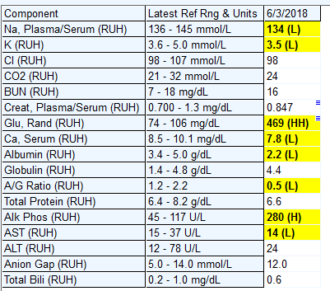
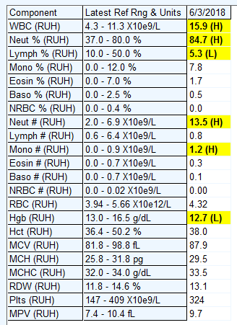
CBC
CMP

Slide 8
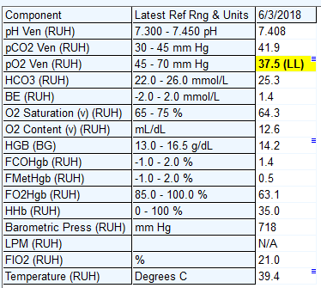
Blood gas, vein
B-Hydroxybutyrate

Slide 9
Legionella
Cryptococcus screen
Histoplasma ab
Pneumocystis

Slide 10
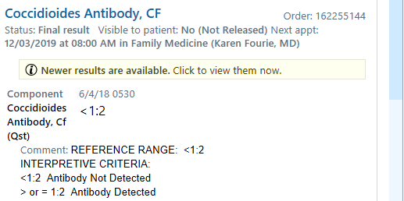

Slide 11
Hospital course
6/3 Admit to MedSurg for CAP Ceftriaxone and Azithromycin (6/3-6/5)
6/5 RRT - Acute hypoxic respiratory failure and sepsis protocol alerted
Patient dessating low 80's on 50 lts facemask. Levaquin.
CXR on shows worsening of airspace disease compared to previous CXR on 6/3.

Slide 12
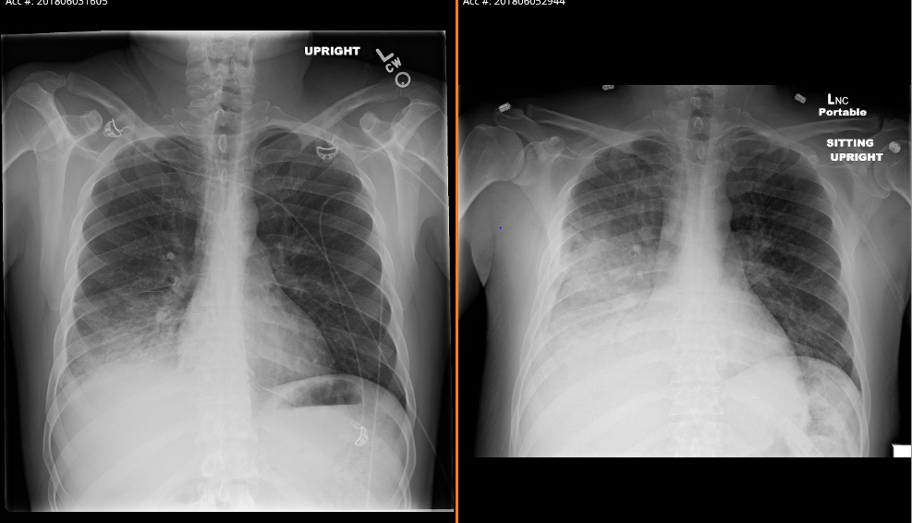

Slide 13
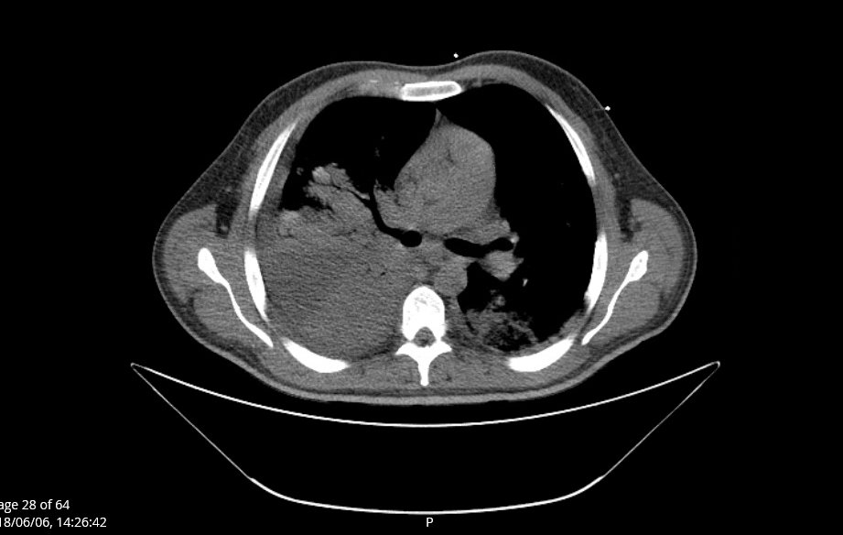
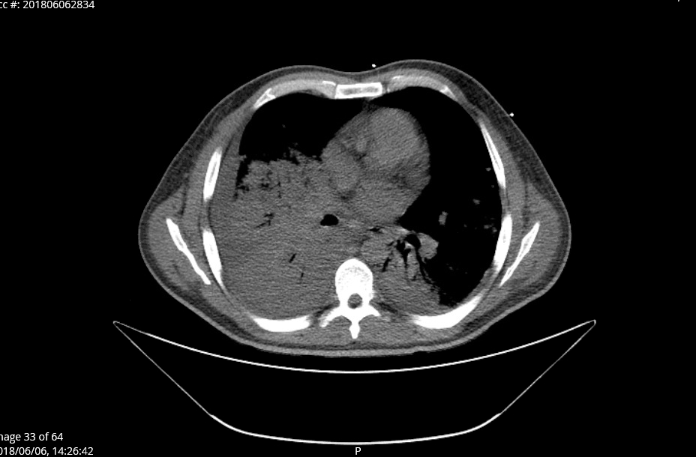

Slide 14
6/6 upgraded to MICU for Acute Respiratory Failure; He was found to have necrotizing PNA of the RLL and RML on bronchoscopy. Pt was start on Meropenen, Fluconazole, Vancomycin, Azithromycin; Pt continue spiking daily fever .
6/7 R pleural effusion and chest tube placement
6/10 Fluconazole was stopped, as cocci and crypto were both negative
6/12 tracheostomy was placed, and chest tube was removed.
Patient was weaned off the vent on, tolerating blow-by and stable for downgrade to the floor

Slide 15
Hospital course
6/14 Sujita: can not r/o coccidioides, cryptococcus, histoplasma, aspergillus infection. Legionella unlikely.
Restart fluconazole 400mg IV Q24 for fungal coverage
Follow up final BAL culture
6/15 Bronchoscopy with bronchoalveolar lavage: (WBC 271 N88% E2%)
6/18 > 24 hours afebrile. BAL 2+ Candida albicans 1+ fungus isolated
6/20 BAL positive for COCCIDIOIDES IMMITIS
6/20 Fluconazol IV Q24 switch to Fluconazole 600 mg PO daily
(6/20 - ) Patient will need to continue with same regimen and completed total of 6 months as per ID recommendation.
6/25 trach decannulation after 2 days of capped trail. At discharge patient was sating 98% breathing at RA without distress.

Slide 16
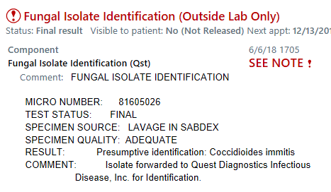
Culture Fungus

Slide 17
What is Coccidioidomycosis?
Also know as Cocci or Valley fever, caused by fungus
Incubation period averages 10-16 days, with a range of less than 7 days to 30 days.
Approximately 30-40% of patients develop symptomatic disease, ranging from a mild influenza like illness, to subacute pneumonia, to, rarely, respiratory failure.
Common symptoms of primary infection are nonspecific and include fever, cough, chest pain, fatigue, dyspnea, headache, arthralgias, and/or myalgias, skin lesion.

Slide 18
People who are at risk for severe or disseminated disease are:
People with compromise or suppressed immune system, like those having HIV, those receiving corticosteroids, and pregnant women (particularly in 3 trimester)
Who is most likely to die from Coccidioidomycosis?
- Native Americans and Hispanics
- Anyone over 65
- People who have condition of a compromised immune system including HIV, TB, DM, autoimmune disease, organ transplant and cancers of the lymphatic cells

Slide 19
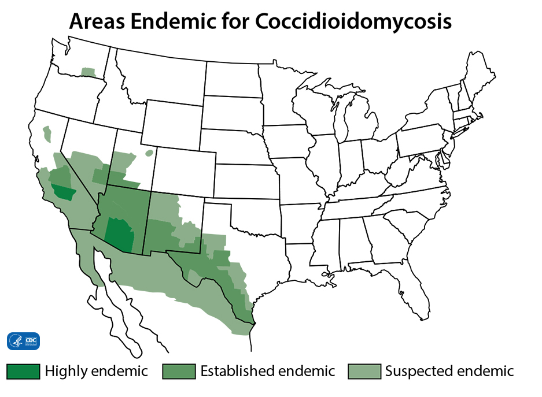

Slide 20
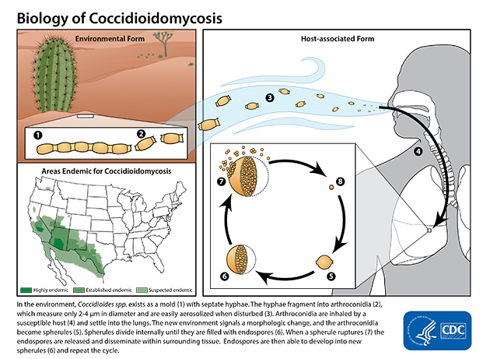
.

Slide 21
Diagnostic test
Patients who are suspected of having Coccidioidomycosis are typically evaluated with Culture, Microscopic examination or serologic testing ( very sensitive)
Eosinophilia
Serologic studies include: Enzyme-linked immunoassays (EIAs) and immunodiffusion tests (ID) to detect IgM or IgG antibodies and (CF) to detect IgG antibody
Antibodies can take weeks to develop. Patients with early infection, repeated serologic testing or attempting to visualize or culture the fungus may be the only way to establish the diagnosis
If ID test is qualitatively positive, complement fixation (CF) test or a quantitative immunodiffusion test should be carried out. These titers can be used to monitor the response to treatment.

Slide 22
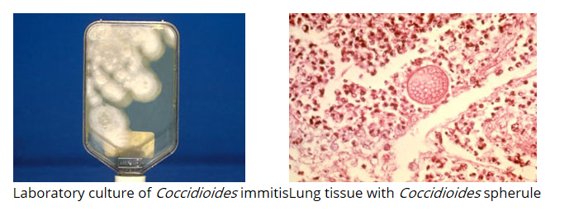
Titers >= 1:4 in serum are consistent with current recent infection, and titer >=1:32 extra pulmonary dissemination.

Slide 23
Treatment
No evidence to determine whether antifungal treatment for uncomplicated coccidioidal infections reduces symptom duration or prevents complications. Some infections will resolve without antifungal treatment.
Infectious Diseases Society of America (IDSA) guidelines suggest treatment for primary pulmonary coccidioidomycosis in patients who:
Are immunosuppressed
Have severe or significantly debilitating illness
Have diabetes or are frail because of age or comorbidities
Are pregnant
Are of African or Filipino ancestry
Disseminated coccidioidomycosis requires antifungal treatment, typically fluconazole or amphotericin B.

Slide 24
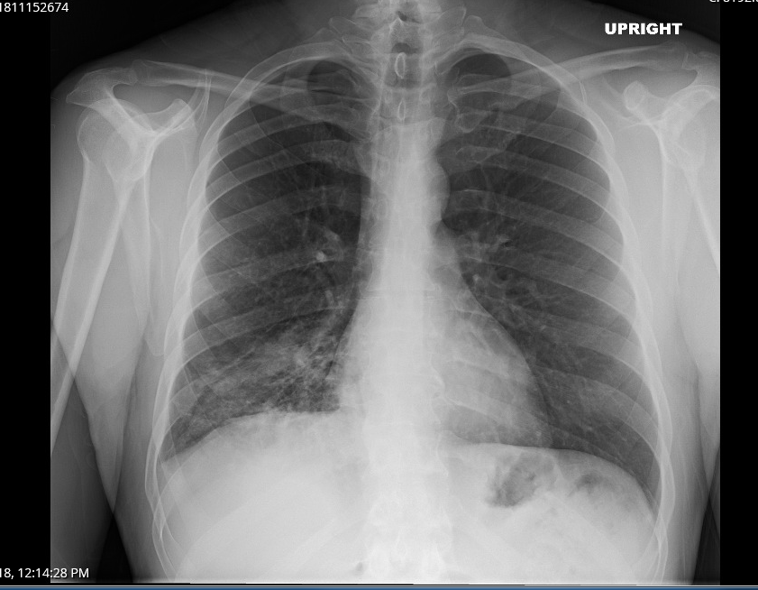
CXR 11/15/2018

Slide 25
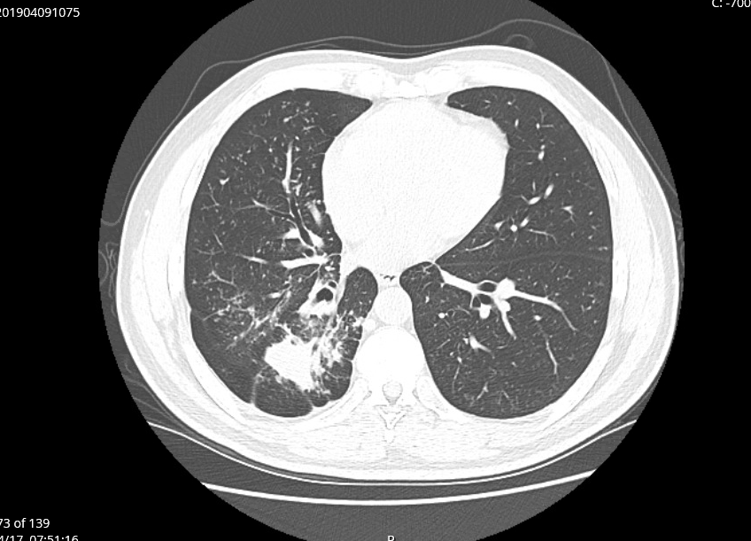
CT Chest 04/2019
continue fluconazole 600 mg PO daily, duration undetermined

Slide 26
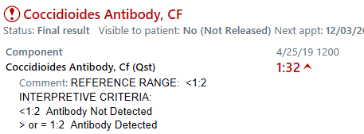
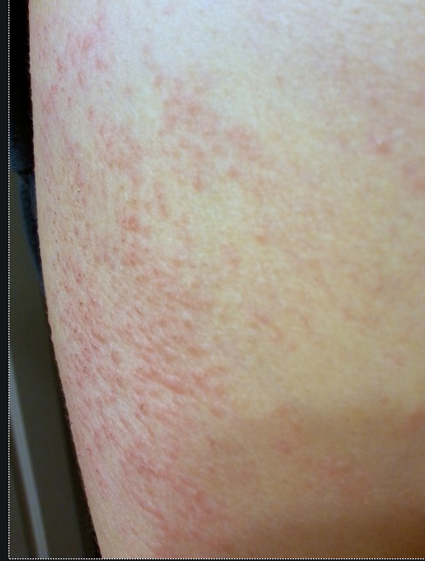

Slide 27
