Slide 1

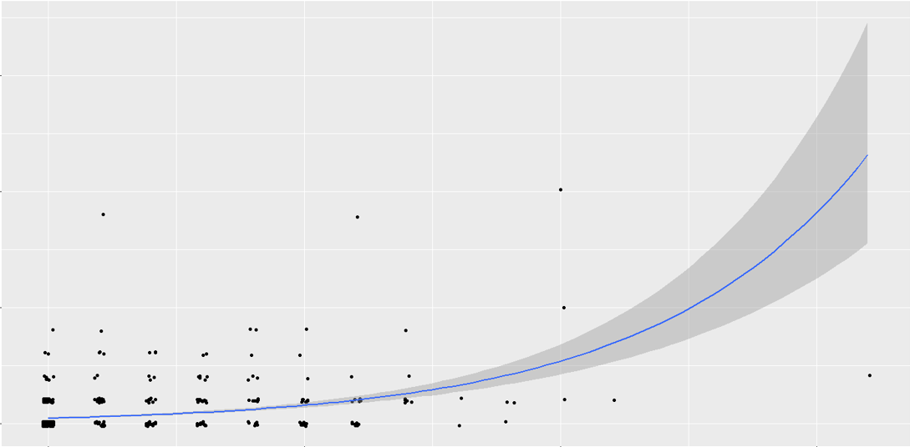
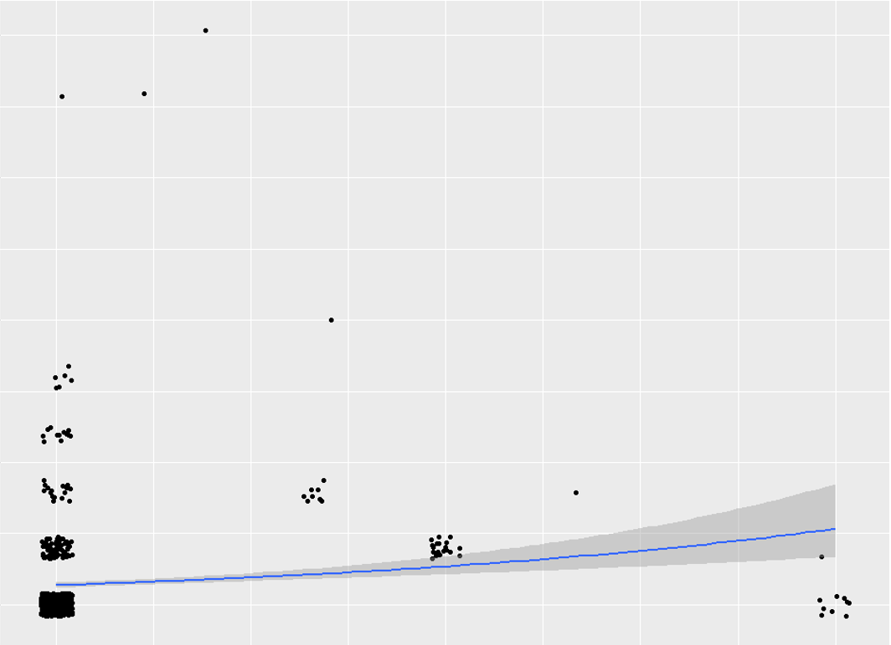

Post-discharge primary care follow-ups:
a key to reducing hospital readmissions?
Michelle Choi, DO, Alicia Lo, MD, Kai Wang, MD, Sang Won, MD
Adviser: Shunling Tsang, MD
Riverside University Health System/ UCR Family Medicine Residency
Total Admission events: 898, yielding 655 unique patients
508 patients with 0 readmission
100 patients in Low readmission group
47 patients in High readmission groip
Background
Hospital readmissions represent a significant healthcare burden in the United States. There were approximately 3.3 million adult 30-day all cause hospital readmissions or roughly 41.3 billion dollars in hospital cost¹.
Our goal is to discover ways to prevent readmissions with the hypothesis that additional PCP visits can reduce hospital readmissions. In a secondary analysis, we look to determine an optimal timeframe for scheduling follow-up visits.
Data
Methods
Patients admitted to the Family Medicine Service at Riverside University Health System (RUHS) from January 1, 2017 – December 31, 2017 were retrospectively studied if intervention of post-discharge follow-up within 7 days made any impact to readmission rate. The data set collected through EPIC for patients with any admissions and then followed for 180 days for additional admission events.
The study has 3 groups: no readmission group, low readmission group (1 readmission in the following 180 days), and high readmission group (2+ readmissions in the following 180 days).
Groups were compared for # of readmissions to # of PCP follow-ups and tracked for increased rate of readmission.
Data was extracted from EPIC using R 3.5 .1 software. Analysis was performed using a set of Poisson regression models. Elixhauser comorbidity scores were calculated within the R program using the comorbidity package.
Table 1: Readmission Group Comparison
 | 0 Readmission |  | 1 Readmission |  | 2+ Readmissions
 | Mean | SD | Mean | SD | Mean | SD
Age | 51.074 | 20.563 | 54.710 | 15.988 | 57.420 | 12.725
Avg 7 day f/u | 0.018 | 0.132 | 0.12 | 0.226 | 0.084 | 0.159
# PCP f/u | 0.453 | 1.313 | 2.630 | 2.710 | 3.064 | 3.158
Elixhauser Score | 3.986 | 2.562 | 6.010 | 2.414 | 8.085 | 3.500
Table 2: Effect of PCP Follow Up
Table 3: Effect of Interval Follow Up
 | IRR * | P-value
# PCP F/U | 1.21 | <0.001
Age | 0.99 | 0.09
Elixhauser Score | 1.30 | <0.001
 | IRR * | P-value
Avg 7 day F/U | 2.93 | <0.001
Age | 0.99 | 0.13
Elixhauser Score | 1.30 | <0.001
Number of Readmissions
Figure 1: Readmission vs #PCP Follow up
*IRR: Incidence Rate Ratio
Discussion
Majority of the patients who were not readmitted within 180 days did not follow up 7 days after discharge, suggesting that not all patients require post-discharge follow up within 7 days as shown with red arrow, which is supported by other studies^{2,4}.
In table 1, the severity of disease, the rate of follow-up within 7 days did not show significant differences among the 3 groups.
Table 2 shows the baseline incident rate of readmission after each PCP visit. And Table 3, as a comparison, shows that the incident rate increased nearly 2 folds if the follow up is within 7 days of discharge. This is likely due to patients’ self awareness of their disease severity, leading to more PCP follow up; which is one limitation of this retrospective study for we are unable to quantify.
10
5
0
0
5
10
Number of PCP Follow up
10
Figure 2: Readmission vs Interval of Follow up
Number of Readmissions
Next Steps:
To stratify which patients need < 1 week follow up on discharge
To compare the social determinants of health between our low and high readmission groups, as it has been shown that these factors can complicate medical care
To schedule patients follow up appointment prior to discharge
To determine the enrollment rate of the high readmission group in our complex care team
7.5
5.0
2.5
0.0
0.0
0.25
0.50
0.75
1.00
Ratio of Admissions with Follow up within 7 days
References:
¹Hine, A. et al. Conditions with the Largest Number of Adult Hospital Readmissions by Payer, 2011. Healthcare cost and utilization project. Statistical Brief #172. April 2014.
²Jackson, C., et al. (2015). Timeliness of Outpatient Follow-up: An Evidence-Based Approach for Planning After Hospital Discharge. The Annals of Family Medicine, 13(2), 115-122. doi:10.1370/afm.1753
³Grafft, C. et al. Effect of Hospital Follow-up Appointment on Clinic Event Outcomes and Mortality. Arch Intern Med. 2010.
⁴Kashiwagi, D. et al. Do timely outpatient follow-up visits decrease hospital readmission rates? Am J Med Qual. 2012.
⁵Katz, A., et al. (2018) Association of the Social Determinants of Health With Quality of Primary Care. Ann Fam Med May/June 2018 16:217-224; doi:10.1370/afm.2236
Special thanks to Cecorc Research Group for statistical analysis support.

