Slide 1


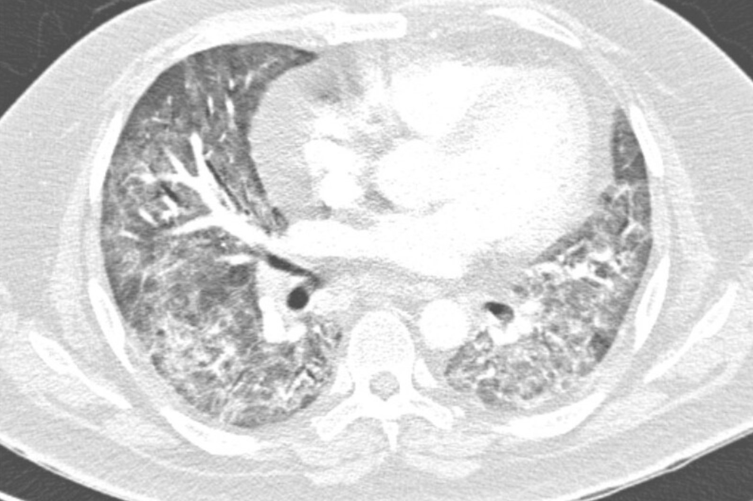
Pneumocystis carinii pneumonia resulting from prolonged course of steroids for COVID-19 pneumonia
Melody Avakian, DO; Sanmisola George, MD; Zahra Sherazi, MD; Faheem Jukaku, MD
RUHS/UCR Family Medicine Program
CASE DESCRIPTION
RESULTS
TREATMENT COURSE
A 47 year old male with past medical history of obesity, dyslipidemia, and fatty liver presents with dyspnea. He was recently hospitalized for acute hypoxic respiratory failure secondary to COVID-19 pneumonia six weeks prior where he was treated for COVID pneumonia and cytokine release syndrome with IV dexamethasone, remdesevir, and tocilizumab. He was discharged home with oral dexamethasone for 30 days for a total treatment duration of 53 days of steroid use. On presentation , returned with worsening dyspnea despite initial improvement. He was admitted for acute hypoxic respiratory failure.
LABS:
Quantiferon Gold - negative
HIV - negative
Histoplasmosis - negative
Coccidioides - negative
Cryptococcus - negative
Aspergillus Ag - negative
Beta-D Glucan - positive
D-Dimer - 0.83
MICRO/PATHOLOGY:
Sputum cultures negative for acid fast, bacteria, or fungal
Flexible fiberoptic bronchoscopy positive for Pneumocystis carinii.
IMAGING:
CT- Angio of the chest with and without contrast showed moderate diffuse bilateral interstitial thickening associated with ground glass opacities.
OUTCOME:
He was started on Bactrim receiving 3 doses with significantly improvement. He was discharged on Bactrim for 3 weeks
FOLLOW-UP:
On subsequent follow up visits three weeks after discharge, he had resolution of symptoms with O2 saturation of 94% on room air.
DISCUSSION
The use of high dose or prolonged courses of steroids are proven to reduce mortality rates in hospitalized patients with COVID-19 infection and respiratory failure who required supplemental oxygen (4). Given that their mechanism involves suppression of the immune system, they can weaken the body’s ability to fight opportunistic infections such as PCP with greater risk with conjunctive use of immune modulators, tocilizumab. Pneumocystis pneumonia should be considered on the differential for a patient who has been treated for COVID-19 with dexamethasone or tocilizumab and presents with worsening or recurrent symptoms.
PHYSICAL EXAM
Vital signs T 101.7, HR 106, BP 88/60, 87% on RA
Constitutional: Obese, alert and oriented x3, Respiratory distress. Diaphoretic. Cooperative.
HEENT: No prominent craniofacial abnormalities; vision grossly intact, EOMI, neck supple and nontender
Cardiac: RRR, S1/S2, no murmur
Respiratory: Diffuse rhonchi in all lung fields, increased work of breathing, symmetrical rise and fall of chest wall
Abdomen: Bowel sounds present, soft, nontender, nondistended
Musculoskeletal: no noted deformities, edema of bilateral LE
Neurological: Cranial nerves are grossly intact, strength 5/5 B/L UE and LE
1. Sokulska M, Kicia M, Wesołowska M, Hendrich AB. Pneumocystis jirovecii--from a commensal to pathogen: clinical and diagnostic review. Parasitol Res. 2015;114(10):3577-3585. doi:10.1007/s00436-015-4678-6
2. McKay LI, Cidlowski JA. Physiologic and Pharmacologic Effects of Corticosteroids. In: Kufe DW, Pollock RE, Weichselbaum RR, et al., editors. Holland-Frei Cancer Medicine. 6th edition. Hamilton (ON): BC Decker; 2003. Available from: https://www.ncbi.nlm.nih.gov/books/NBK13780/
3 Maude SL, Barrett D, Teachey DT, Grupp SA. Managing cytokine release syndrome associated with novel T cell-engaging therapies. Cancer J. 2014;20(2):119-122. doi:10.1097/PPO.0000000000000035
REFERENCES

