Slide 1
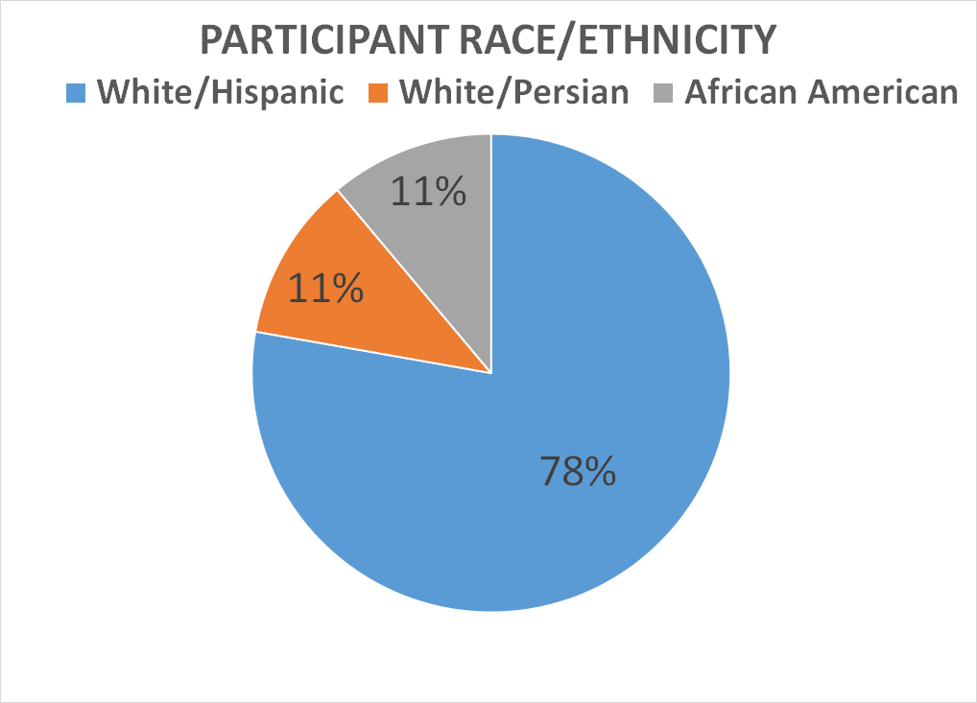
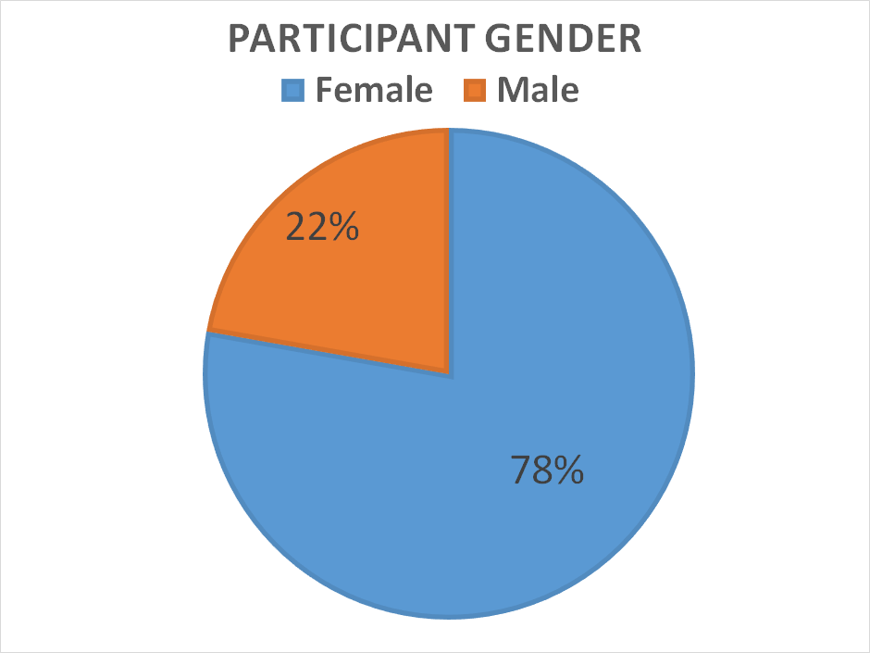
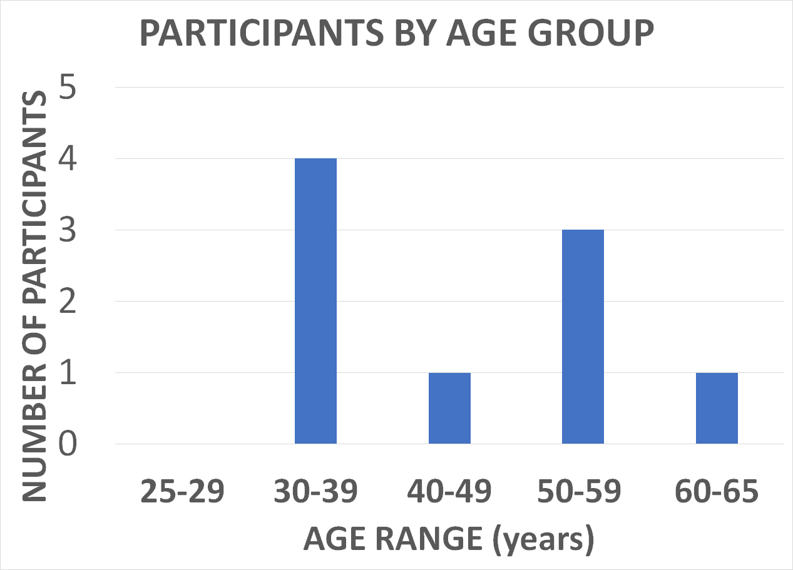
Medication Treatment of Depression​: Evaluation of Follow-up Visits by Telephone
​
Barbara Ackerman PhD, Nathan McLaughlin MD, Heidi Pang DO, Maria Bahramzi MD, Hiren Swami MD,
Lina Hadj Smaine DO, Laura King DO, Lianna Navar MD, Alex Vo MD, Nasim Faryabi DO, Pooja Vijayendra DO
Moreno Valley Community Health Center--Moreno Valley, CA​
Department of Family Medicine/Riverside University Health System
INTRODUCTION
PRELIMINARY RESULTS
DISCUSSION/CONCLUSION Cont'
In 2016, approximately 45 million adults in the U.S. were affected by mental illness. Patients often rely on primary care physicians for mental health services due to a critical shortage of psychiatrists, avoidance of stigma, and comfort with the family physician.
Previous research has shown that telemedicine can play an important role in treating mental illness. Our preliminary results show that frequent telephone visits can be helpful in improving medication adherence and reducing symptoms of MDD by providing more support for a patients who already have moderate to high rates of non-adherence.
Telephone visits are helpful in identifying potential problems of early medication discontinuation, such as early side effects or not being able to pick up the medication. Telemedicine visits are also helpful in addressing if referrals to behavioral health are appropriately processed.
Some limitations of the study include small sample size, age restrictions and excluding severe major depressive disorder. Enrollment of participants was hindered by COVID-19 Pandemic, but we plan to enroll up to 60 participants to complete this study.
Our study focuses on demonstrating the effects of short- term follow-up visits for up to 6 weeks from initiating a prescribed SSRI. Further research is needed to better understand the long-term benefits and to determine the ideal follow-up timeline for patients with mild to moderate MDD.
Primary care physicians often treat major depressive disorder (MDD) with first-line selective serotonin reuptake inhibitors (SSRIs), however 40-67% of patients discontinue their antidepressants within the first 3 months. Lack of proper follow-up occurs in almost 70% of cases. ​
​
A follow-up phone visit at 2, 4 and 6 weeks after medication is prescribed may foster better medication adherence and expose barriers as compared to the 4-6 week follow-up care as usual.
METHODS
9 Enrolled Participants
5 in "Experimental Group"
2 weeks phone visit
4 in "Control Group"
Usual care follow-up
4 weeks phone visit
6 weeks phone visit
Inclusion Criteria:
Newly diagnosed initial or recurrent episode of MDD
Mild to moderate level of severity of MDD as measured by PHQ-9: (mild score of 5-9, moderate score of 10 –14 ; moderately severe score of 15 –19)
Consent to treatment with SSRI
Patient agrees to speak with one of the researchers about the study
REFERENCES
The average decrease in PHQ9 score = 10.6 points
1. Basit, Saadia A., et al. “Telemedicine Interventions for Medication Adherence in Mental Illness: A Systematic Review.” General Hospital Psychiatry, Elsevier, 13 Nov. 2019, www.sciencedirect.com/science/article/abs/pii/S0163834319302713.
2. “Final Recommendation Statement: Depression in Adults: Screening: United States Preventive Services Taskforce.” Final Recommendation Statement: Depression in Adults: Screening | United States Preventive Services Taskforce, 26 Jan. 2016, www.uspreventiveservicestaskforce.org/uspstf/document/RecommendationStatementFinal/depression-in-adults-screening.
3. Ho, Siew Ching, et al. “Barriers and Facilitators of Adherence to Antidepressants among Outpatients with Major Depressive Disorder: A Qualitative Study.” PloS One, Public Library of Science, 14 June 2017, www.ncbi.nlm.nih.gov/pmc/articles/PMC5470687/.
4. M;, Posternak MA;Zimmerman. “Therapeutic Effect of Follow-up Assessments on Antidepressant and Placebo Response Rates in Antidepressant Efficacy Trials: Meta-Analysis.” The British Journal of Psychiatry : the Journal of Mental Science, U.S. National Library of Medicine, pubmed.ncbi.nlm.nih.gov/17401033/.
5. “Mental Health Care Services by Family Physicians (Position Paper).” AAFP Home, www.aafp.org/about/policies/all/mental-health-services.html.
6. Moise, Nathalie, and Louise Falzon. “Interventions to Increase Depression Treatment Initiation in Primary Care Patients: a Systematic Review.” Journal of General Internal Medicine, Springer US, 14 Aug. 2018, link.springer.com/article/10.1007/s11606-018-4554-z.
7. Schulze, Lara N., and Ulrike Stentzel. “Improving Medication Adherence With Telemedicine for Adults With Severe Mental Illness.” Psychiatric Services, 17 Jan. 2019, ps.psychiatryonline.org/doi/full/10.1176/appi.ps.201800286.
8. Stettin, Glen D. “Frequency of Follow-up Care for Adult and Pediatric Patients During Initiation of Antidepressant Therapy.” AJMC, www.ajmc.com/view/aug06-2341p453-461.
9. The MacArthur Initiative on Depression and Primary Care – Depression Management Tool Kit. 2009. https://www.integration.samsha.gov/clinical-practice/macarthur_depression_toolkit.pdf 44 pages
Exclusion criteria: ​
Under age 25 or over age 65 ​
Already using an SSRI for MDD
Allergy or contraindication to SSRI
Bipolar Disorder, other psychiatric disorders, substance use disorders, personality disorders and psychotic disorders ​
Severe MDD, with or without psychotic features (PHQ-9 score of ≥ 20) ​
History of past or current suicidal/homicidal ideation/intent ​
History of past psychiatric hospital admission ​
Current use of palliative medicine or hospice services ​
Grieving
The PHQ9 increased slightly over time; the average increase = 1 point
DISCUSSION/CONCLUSION
Successful treatment of major depressive disorder (MDD) involves a multifaceted approach with a combination of regular follow-up visits, prescribed medication and/or behavioral therapy.

